Slide 1

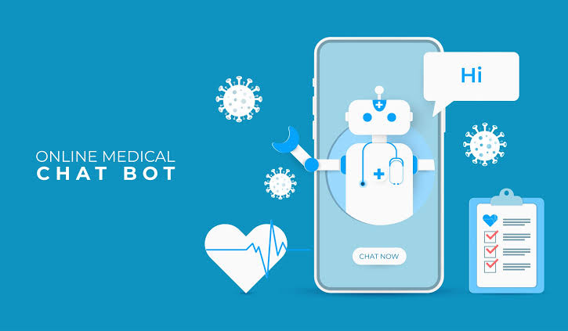
Medical Appointment Chat Bot Presentation

Slide 2
Table of Content
Introduction
Problem Statement
Purpose
Project Description
Project Goal
Project Output
Alternative Solutions
Expected Benefits
Mission Critical Statement
Proposed Time Table
Work Breakdown Structure
PERT Chart
Gantt Chart
Modules/Users
Use Case Diagram
State Chart
Data Flow Diagram
Requirements
Software Requirements
Hardware Components
Advantages
Disadvantages
References

Slide 3
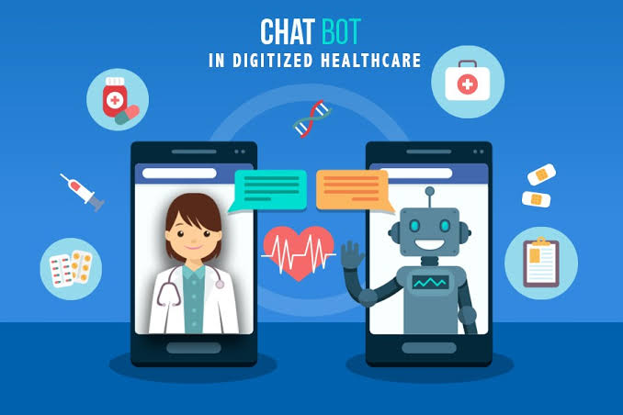
1. Introduction
It is quite apparent that as time changes health is imperative in our daily lives. We’ve had a pandemic that has shown us that health is our greatest gift and should be treasured. Seeing a doctor is a must, but you ought to make an appointment to see that doctor.
When patients are too busy, the last thing they want to do is pay a visit to the doctor’s clinic in person, to queue in a long line and make an appointment.
Hence it is important to work alongside an Appointment Chatbot, that will help eliminate all these discomforts of visiting a doctor or waiting in line to make an appointment.
This system provides an easier way for rescheduling, cancellation and booking an appointment. And relieves workers of tedious tasks and help the company with utilizing its workers in an effective way.
A chatbot is software that is designed to interact like a human. Whenever a visitor visits your website. (Jake Frankenfiel, 2022)

Slide 4
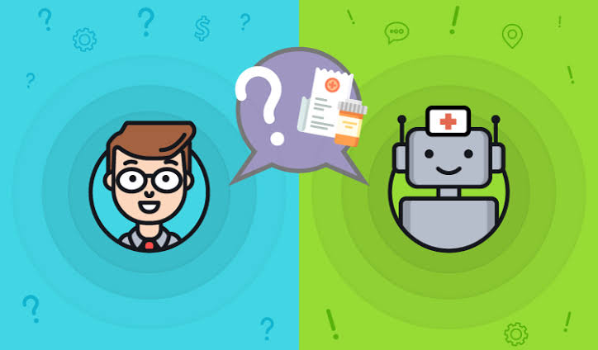
2. Problem Statement
Artificial intelligence, chatbot is a technology that makes interactions between man and machines using natural language possible. From literature, we found out that in general, chatbot are functions like a typical search engine. Although chatbot just produced only one output instead of multiple outputs/results, the basic process flow is the same where each time an input is entered, the new search will be done. Nothing related to previous output. This research is focused on enabling chatbot to become a search engine that can process the next search with the relation to the previous search output. In chatbot context, this functionality will enhance the capability of chatbot’s input processing. (Amplework Software pvt, 2021)

Slide 5
3. Purpose
It’s only natural to be met with raised eyebrows while mentioning healthcare and AI chatbots in one sentence. But chatbots are quite the opposite of a threat for the medical industry. They are built to perform basic and repetitive tasks that can streamline the day-to-day functioning of a medical practice. Most of all, they assist with appointment scheduling. Think of medical chatbots as virtual assistants for your clinic, hospital, or healthcare centre. They’re inexpensive, easy to add to your website, and highly efficient at what they do. (Konstantin Kalinin, 2020)
The overall purpose of is to minimize while booking appointments such as double bookings and incorrect time selection, minimise driving for enquires, familiarize people to machine interactions, decrease lines and cluster in medical canters, increase the dependency technological assistance by medical staff.

Slide 6
4. Project Description
4.1. Project Goal
4.2. Project Output

Slide 7
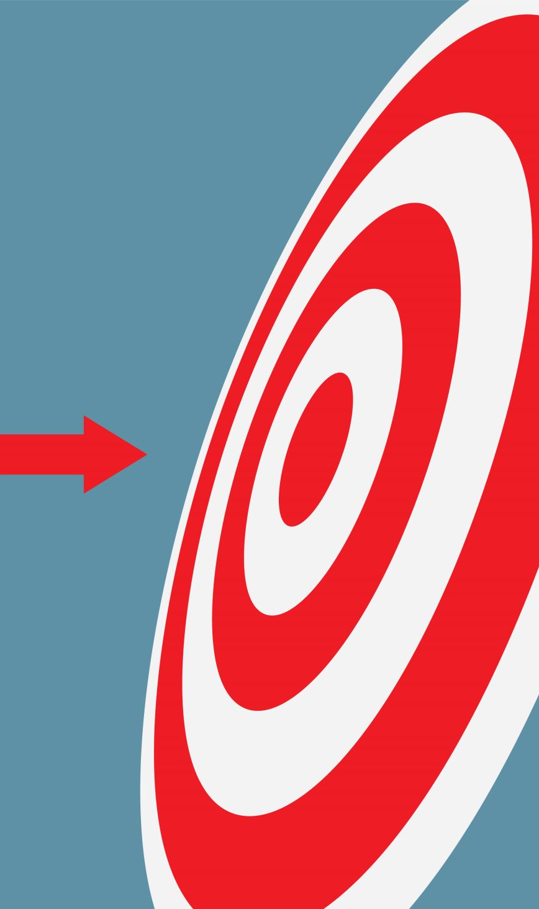
4.1 . Project Goal

Slide 8
4.1. Project Goal
A medical chatbot facilitates the job of a healthcare provider and helps improve their performance by interacting with users in a human-like way. There are countless cases where intelligent medical chatbots could help physicians, nurses, therapists, patients, or their families. They can step in and minimize the amount of time they spend on tasks like:
providing health-related information to users
guidance for patient
Maintaining multiple patient interaction
connecting people and organizations with first responders
Conduct tedious repetitive tasks
FAQ-type queries (contact details, directions, opening hours and service/treatment details)
It’s important to note that despite the fact that chatbots can offer valuable facts and symptoms, they aren’t qualified to give an official diagnosis. The main premise behind these talking or texting smart algorithms is to become the first point of contact before any human involvement is needed.
(Abhinav Girdhar, 2022)

Slide 9
4.2. Project Output
Immediate access to health care staff
A chatbot quickly assists you with any front desk related issue but not all
Health monitoring and additional information
Patients need more than urgent medical attention. So, ongoing, post-discharge care can be virtually assisted by a bot.
Easy-to-use for doctors and patients
Conversational interfaces are very accessible and don’t have the complexities and learning curve typically associated with new technology.
Scalability
With technology, healthcare companies can deliver customer service without requiring additional resources (like human staff).
Convenient for a mobile-first consumer base
Mobile phones are one of the preferred methods of communication with brands, especially for certain demographics. Medical institutes can cater to that audience.
Improved patient satisfaction
These applications help overcome staff shortages with robotic assistance. No issue will be left unattended.
(Abhinav Girdhar, 2022)

Slide 10
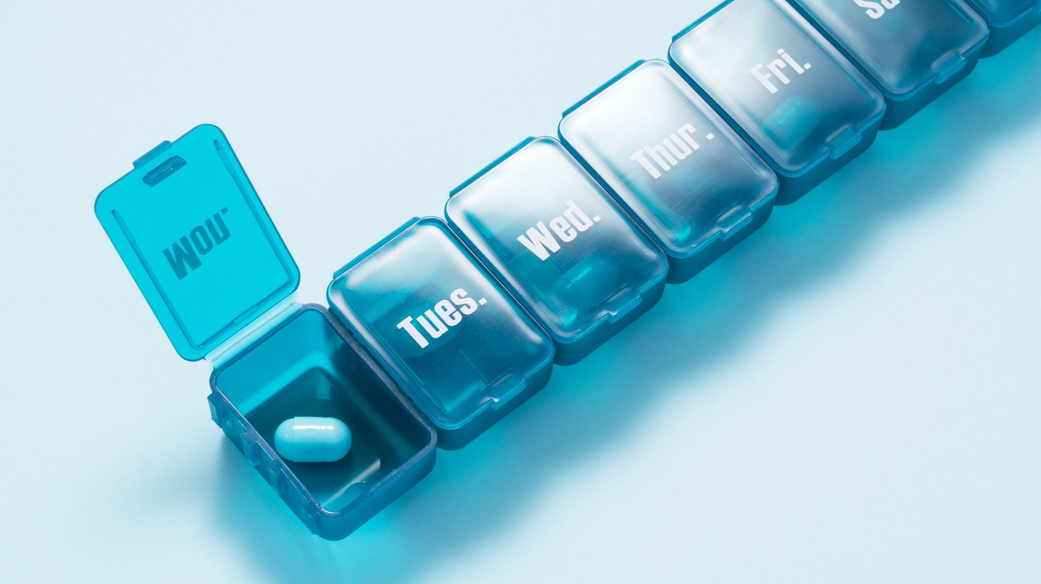
5. Alternative Solutions
Alternative solutions to the modern chatbot box are quiet limited including :
Physically going or calling about booking, cancelling or queering an appointment
Physically talking to a doctor about ones medical condition
Going to companies website
Google/research solutions and symptoms

Slide 11
6. Expected Benefits
Reduced waiting times:
Chatbots in the healthcare system prevent long hospital queues by providing patients with instant answers.
Massive reduction in costs:
Chatbots help to significantly reduce patient cost to make schedule, reschedule and cancel appointments, also reducing business operational costs even though unemployment might be the results.
Timely medical information:
Care chatbots help provide instant information, which can help person.
Ease the burden on doctors:
It is nearly impossible for doctors to attend to all patients on a tight schedule, whereas medical chatbots are accessible 24*7.
Real-time interaction:
Chatbot provides immediate responses and changes the response, depending on the input, just like real-time interaction with a doctor.
Scalability:
Chatbots can seamlessly handle numerous customers without compromising the quality or adding to the cost.
Patient satisfaction:
A healthcare chatbot safely provides timely and intelligent solutions, which, in turn, increases patient satisfaction.
(Konstantin Kalinin, 2020)

Slide 12
7. Mission Critical System
The main part of a medical appointment chatbot is, Schedule Appointment, Reschedule Appointment, and Delete Appointment but other features which are essential include:
Answer FAQs
Available 24×7
Improve patient engagement
Decrease Human resource dependency

Slide 13
8. Proposed Time Table
Work Breakdown Structure
PERT Chart
Gantt Chart

Slide 14
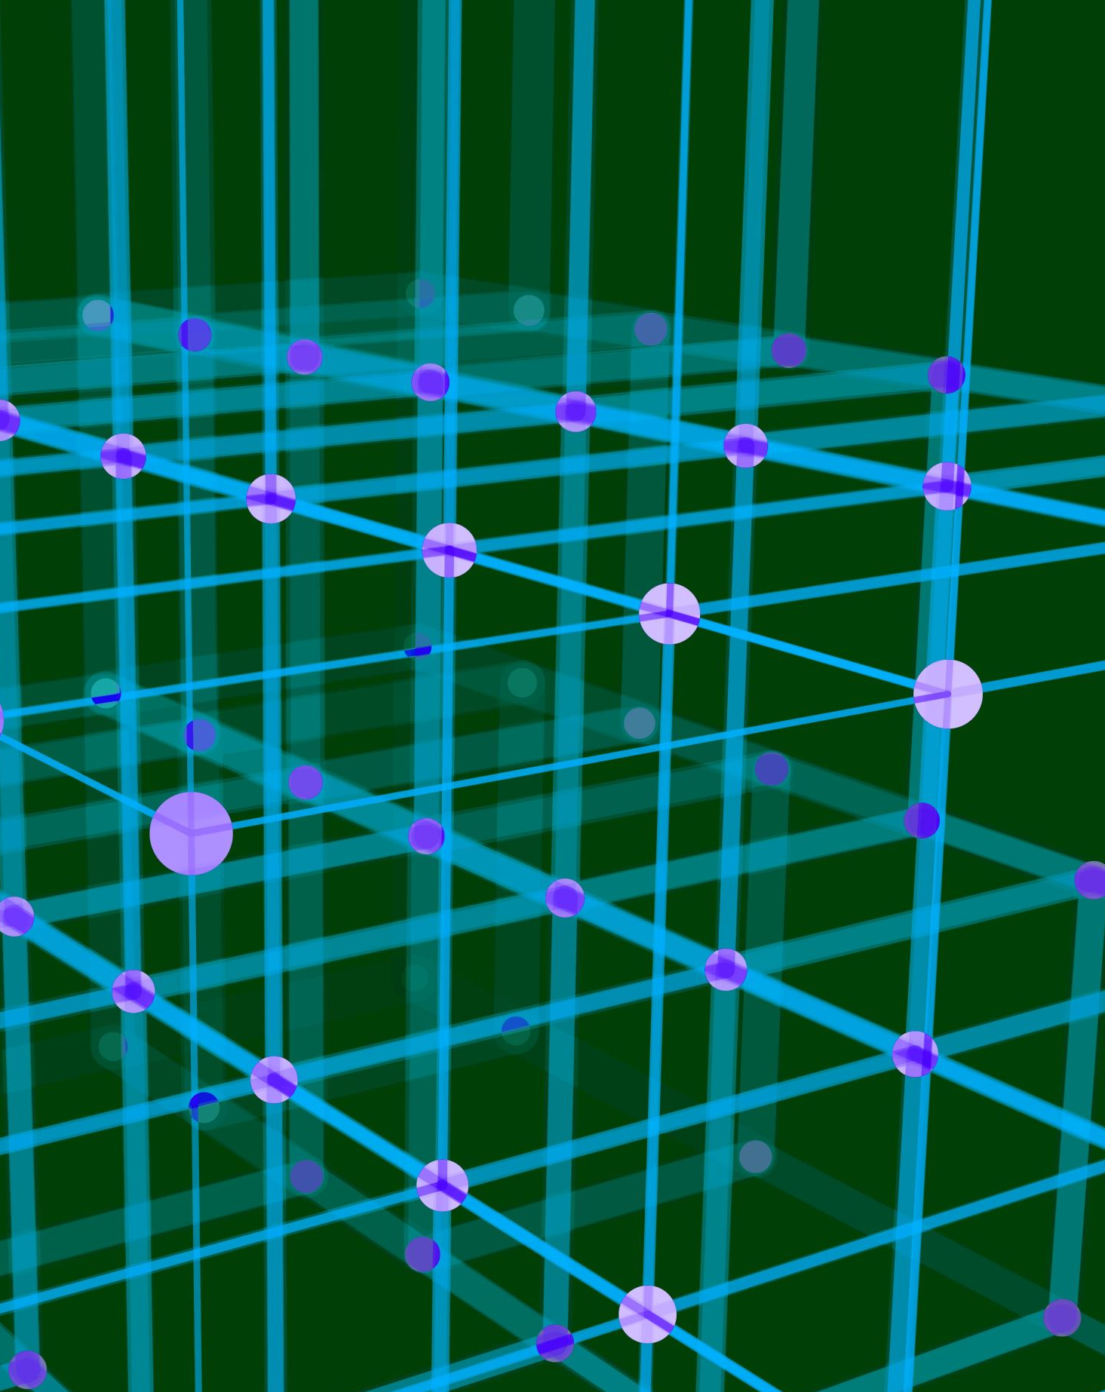
8.1. Work Breakdown Structure

Slide 15
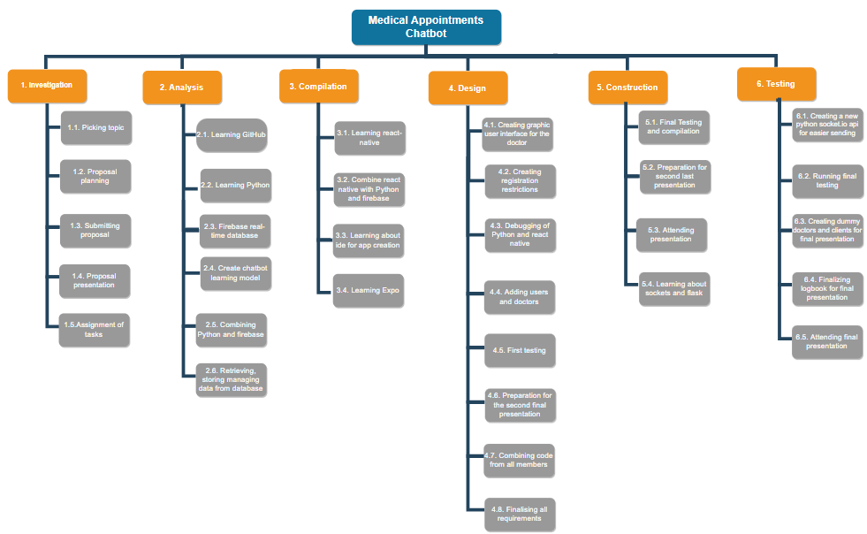

Slide 16

8.2. PERT Chart

Slide 17
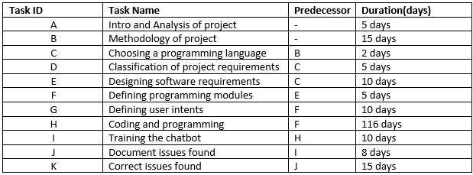
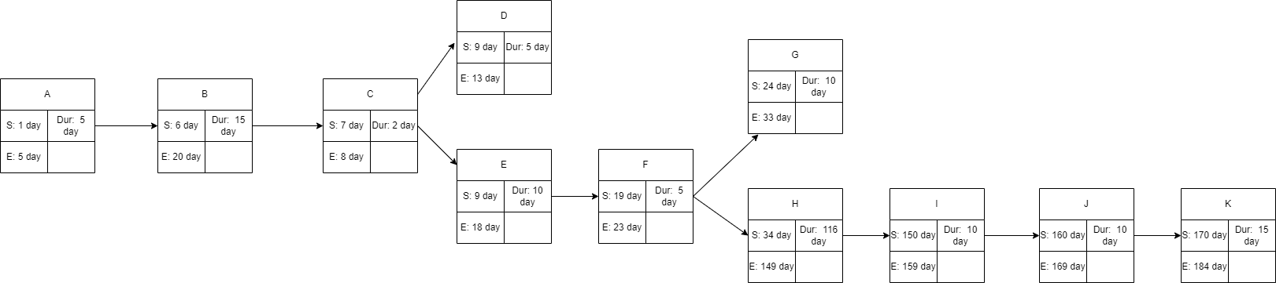

Slide 18

8.3. Gantt Chart

Slide 19
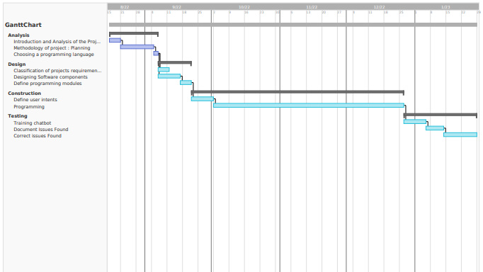

Slide 20
9. Modules / Users
Use Case Diagram
State Chart
Data Flow Diagram

Slide 21

9.1. Use Case Diagram

Slide 22
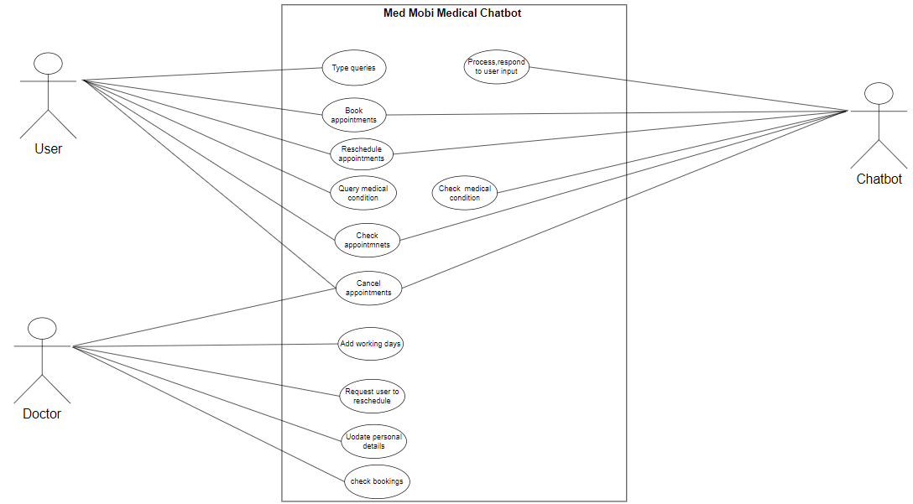

Slide 23
9.2. State Chart

Slide 24
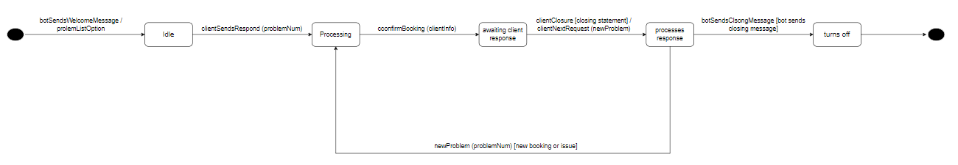

Slide 25

9.3. Data Flow Diagram

Slide 26
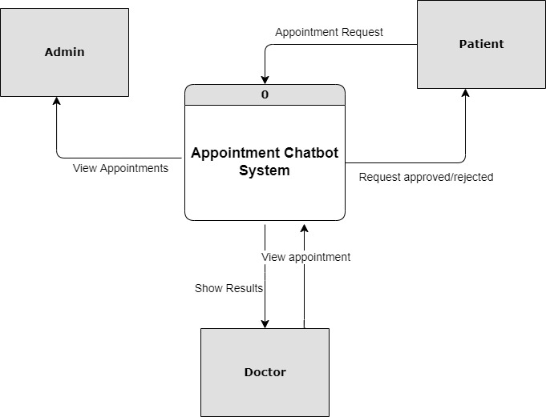

Slide 27
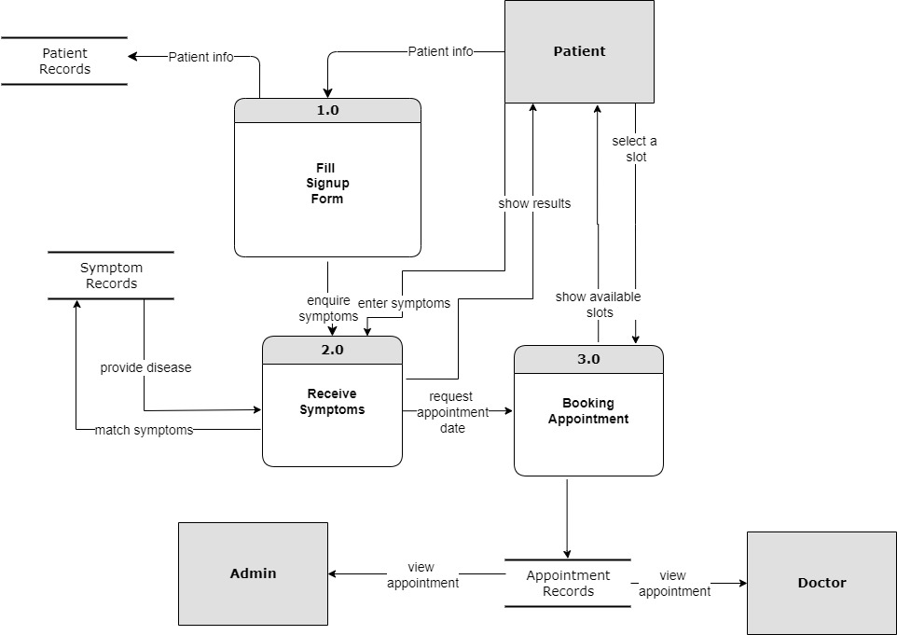

Slide 28
10. Requirements
Software Requirements
2. Hardware Components

Slide 29
10.1. Software Requirements
Flexible Internet connection
The chatbot need to access a real time database for storing fetching and verification of data so it requires good to strong internet connection. The chatbot requires to check user input to understand the intent of the data and send back the most probable answer to the user input.
Multi-platform capability
chatbot communicates seamlessly across multiple channels such as websites, apps, messenger, phone systems. For a seamless experience, it is also useful if data and context can be stored over several channels. If a customer shares his order, email address or other information with the bot, it can use this input for further actions on other channels. Moreover, it should be possible to pass on all to a live agent if necessary.
Easy handling
In addition, the chatbot software has to be able to handle the huge amount of data without any problems. It has to be possible to edit corporate identity settings, change and add content quickly, send notifications to employees and have a clear and structured overview of conversations. Well-designed user interfaces and experiences (UI / UX), both on the company and customer side, are essential.
Ongoing optimization
Every single customer interaction represents a way of learning for artificial intelligence (AI). The more often a chatbot is used, the better it gets because it can access more and more data with continuous use. Therefore, a chatbot software should continuously expand its own knowledge base by analysing conversations.
Analytics & reporting
An outstanding chatbot is an excellent source of data and customer information. However, if you cannot extract it and use it to increase your knowledge, it will be of little use.
(Stephanie, July 30th, 2020)

Slide 30
10.1.1. Functional Requirements
Understand queries
Comprehend and understand the query users have, to be able to respond to a query.
Fetching relevant information
based on the user queries to respond accurately and personalised responses
Provide Fast feedback
Essentially a chatbot is close simulation of a conversation therefore a quick response is needed and even if the is no response to give a reminder or a response of the on going conversation is required.
Providing essential or additional medical information
Availability - The system is available all the time.
Adding Patients and doctors
(Sanjana, 2019)

Slide 31
10.1.2. Non Functional Requirements
User Identification:
The system needs the patient to recognize herself or himself using the phone and adjust, specify and personalise responses based on the user.
Administrator rights:
The administrator can view as well as alter any information, as well as practitioners can be able to add information about medication administration and potentially lifestyle adjustment.
Modifications:
Modifications like insert new practitioner information and new booking information, delete old bookings, update information, and clients.
Response Time:
The system provides responses fast mimicking a normal human-to-human conversation and have a response for when the conversation is on pause. (Sanjana, 2019)

Slide 32
10.2. Hardware Components
With technology advancing at a rapid rate on a daily bases the use of technology has evolved from a want to need in todays age, medical chatbot is still one of the simplest software to use online. A client with:
Internet Accessible Device - Anybody who has a device that can access good internet connection can access and use this chatbot feely and quickly
Modern Graphic Accessibility - Any device that can view graphics properly can use this medical chatbot
While creating a chatbot requires extensive knowledge of programming languages(python) and the use of Morden IDE’s, a device, and a device that can use a IDE, will be able to create a working chatbot.

Slide 33
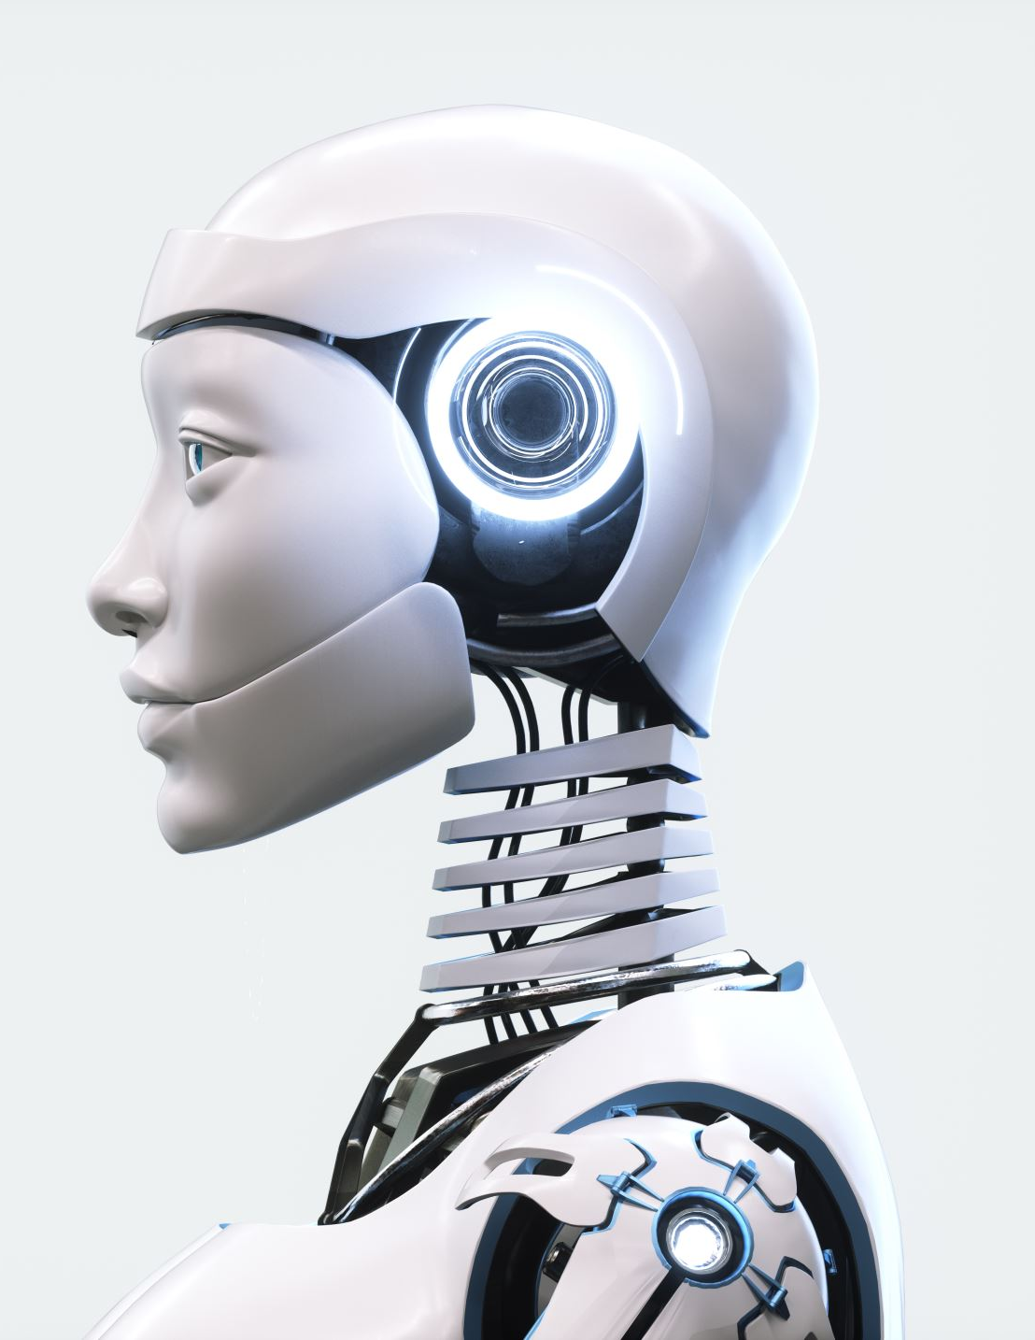
11. Advantages
Chatbots are convenient for providing customer service and support 24 hours a day, 7 days a week. They also free up phone lines and are far less expensive over the long run than hiring people to perform support.
AI and natural language processing, chatbots are becoming better at understanding what customers want and providing the help they need. Companies also like chatbots because they can collect data about customer queries, response times, satisfaction, and so on. (Amplework Software pvt, 2021)

Slide 34

11. Advantages
Less time spent commuting to the doctor’s office
Less money spent on unnecessary traveling
Easy access to seeing the doctor at the push of a button
Availability 24/7
Lower costs customer service
By replacing a human with a chatbot, you can minimize your operational cost. It is difficult for a corporation to hire employees for each role A single operator can only handle one or two customers at a time, but a chatbot can handle several interactions at once, which is much more when compared with your service or sales team. can handle. Chatbots help businesses to save a lot of money, while also being easily adaptable to satisfy a variety of needs, depending on the application. (Jake Frankenfiel, 2022)
Reduced errors
Chatbots help to minimize errors, unfortunately, customer support representatives can do make mistakes (human error) in providing appropriate information to the customers. But the chatbot flow contains pre-written information, intelligent algorithms, and programming, which ensures proper data output. (Elaine Tveit, 2021)
Provide faster customer service
Chatbots don’t take lunch, coffee, or bathroom breaks, they don’t nap at their desk, and they don’t wait for someone else to take a turn answering messages. They’re computer programs, which means they have no physical needs or emotions. It also means they can respond almost immediately to customer service requests. They may take a few seconds to analyse a customer’s question or response and determine the appropriate reply, but the wait time is typically not long. (Elaine Tveit, 2021)
Can be used as a sales & marketing tool
(Abhinav Girdhar, 2022)

Slide 35
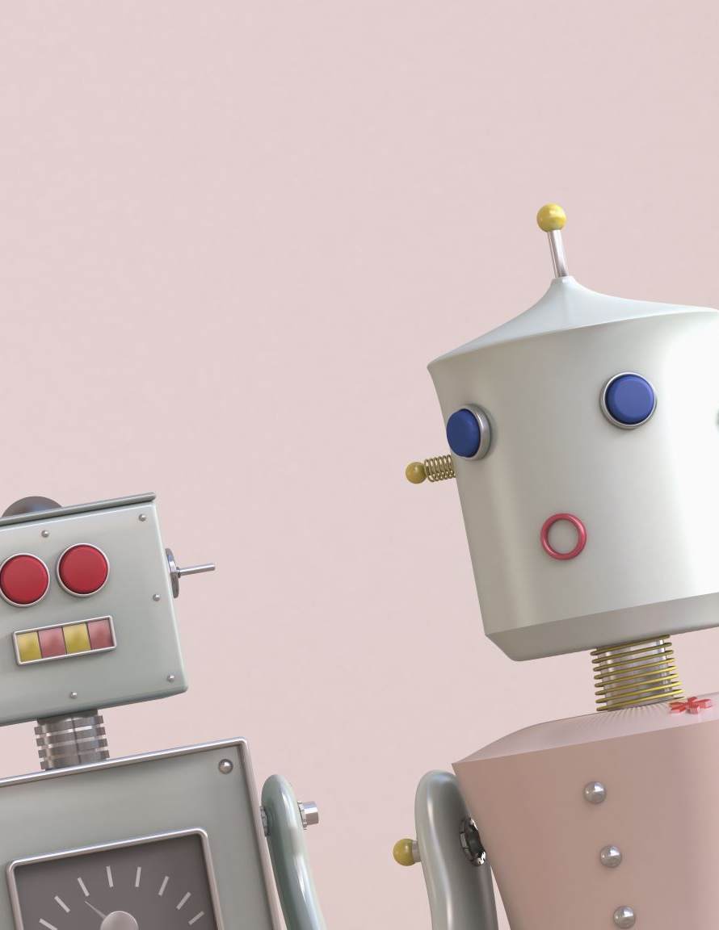
12. Disadvantages
Chatbots, however, are still limited. Even with natural language processing, they may not fully comprehend a customer's input and may provide incoherent answers. Many chatbots are also limited in the scope of queries that they can respond to.
This may lead to frustration with a lack of emotion, sympathy, and personalization given fairly generic feedback. In addition to customer dissatisfaction with not reaching a human being, chatbots can be expensive to implement and maintain, especially if they must be customized and updated often.

Slide 36
12. Disadvantages
May not understand user queries
To ensure that the chatbot provides the correct information to the customer. It’s natural for users’ and businesses’ goals to vary as a result of their engagements. Therefore, the chatbot must be updated with the correct information to meet client demands.
Limited responses
This challenge is mostly found in chatbots that are not AI-Powered. Some chatbots are rule-based, meaning their responses are limited, and this can be a disadvantage. Customers could become frustrated when they do not get the right responses and keep getting fed what has been programmed into the chatbot.
Lack emotions and its not a personalised experience
Chatbots can’t sense when a customer is in distress. They lack empathy and personalization. The lack of emotional reassurance or human connection can cause a customer to seek service elsewhere, which is exactly what you don’t want to happen.
They can be hard and expensive to install, deploy, set up and maintain
Chatbots can take a long time to set up and deploy into the workforce. If they are based on flow builders, you will have to build the chatbot flows from the ground up yourself or hire someone to do it. This process could take months to finish. A chatbot can be time-consuming and tricky to set up. It’s a complex program that requires constant maintenance and attention, during both initial deployment and long-term use.
Less understanding and natural language
People in today’s world use shortcut keys to speed up responses and increase efficiency. As a result, chatbots are unable to adapt their language to that of humans. So slang, misspellings, and sarcasm are frequently misunderstood by bots. It means that a chatbot is unacceptable for a friendly discussion.
(Abhinav Girdhar, 2022)

Slide 37
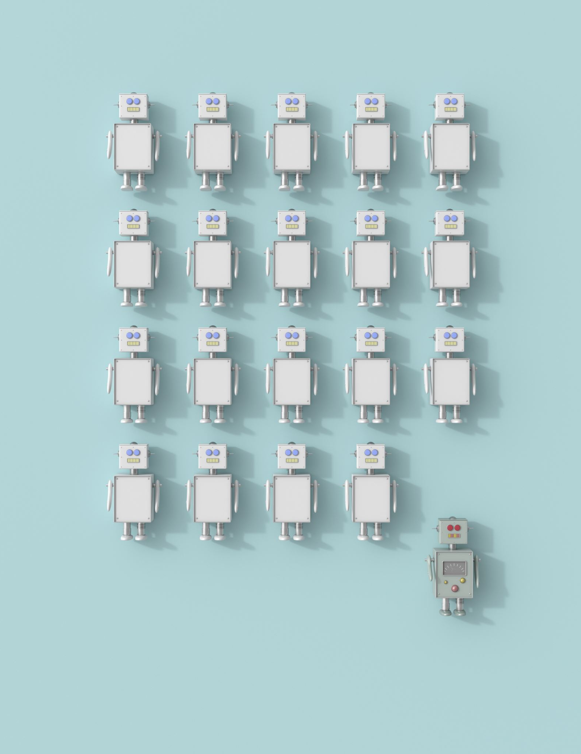
Conclusion
People in today’s world use shortcut keys to speed up responses and increase efficiency. As a result, chatbots are unable to adapt their language to that of humans. So slang, misspellings, and sarcasm are frequently misunderstood by bots. It means that a chatbot is unacceptable for a friendly discussion.
Inclusion the Healthcare chatbot is gradually eliminating waiting timings at hospitals, appointments, and consultation meetups, and helping patients connect with the right doctor instantly. Healthcare chatbots also give more time to patients to make them understand the treatment. With these features, the chatbot in healthcare brings help to be patient even without visiting a hospital. Healthcare chatbots can save many resources just by themselves, and these resources can help save and treat many more people.

Slide 38
13. References
Jake Frankenfield, May 18, 2022 , Chatbot , from https://www.investopedia.com/terms/c/chatbot.asp
Stephanie, July 30th, 2020, from https://onlim.com/en/top-requirements-for-chatbot-software/32465
Abhinav Girdhar, February 16, 2022, from https://www.appypie.com/healthcare-chatbot-advantages
Amplework Software pvt.ltd, August 12, 2021, from https://www.amplework.com/blog/healthcare-chatbots-pros-challenges-future/
Konstantin Kalinin, August 12, 2020, from https://topflightapps.com/ideas/chatbots-in-healthcare/
Elaine Tveit, December 5, 2021, from https://blog.sapling.ai/the-advantages-and-disadvantages-of-using-a-chatbot/
Zebra Buzz, September 8, 2020, From https://zebrabuzz.com/advantages-and-disadvantages-of-chatbots/#:~:text=Some%20of%20the%20advantages%20and%20disadvantages%20of%20Chatbots,Use%20Chatbots%20Successfully%20Limited%20Responses%20High%20Installation%20Costs
Ram Ganesa Athreya, May 06, 2017, Chatbot for Dbpedia, from GSoC 2017 Proposal - Chatbot for DBpedia (slideshare.net)
Sanjana, August 14, 2019, The functional and Non-functional requirements requirements for hms, from The Functional and Nonfunctional Requirement for HMS (mocdoc.in)

